Slide 1
Broadcasting Webservice for Smart TVs
Karlsruhe Institute of Technology
Lennard Kittner, Henry Boos,
Jiangang Huang, Sicheng Dong,
Jannik Wibker

Slide 2
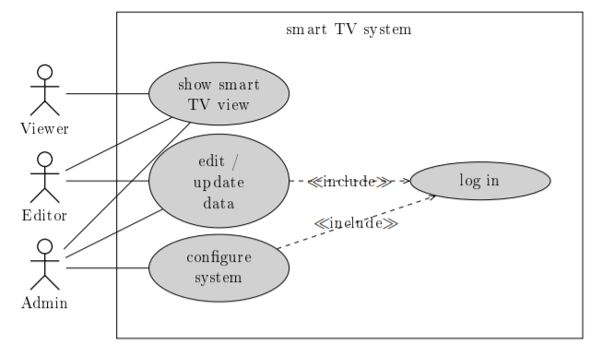
Use Case Diagram

Slide 3
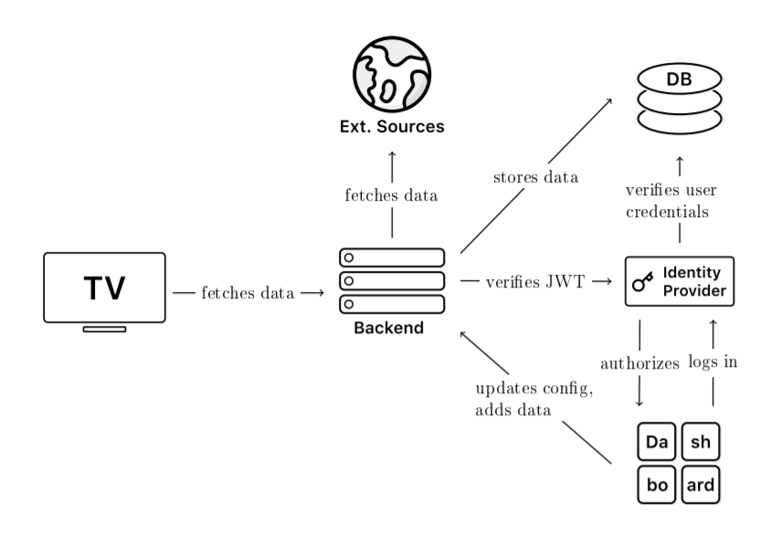
General Concept

Slide 4
Mandatory Requirement
Layout System
Plugin system
Internationalization system
Time-configurable widget display
Permission System
Dashboard for configuration and data entry
Calendar widget
Publication
Announcements
Clock widget
Error logging
Cafeteria widget

Slide 5
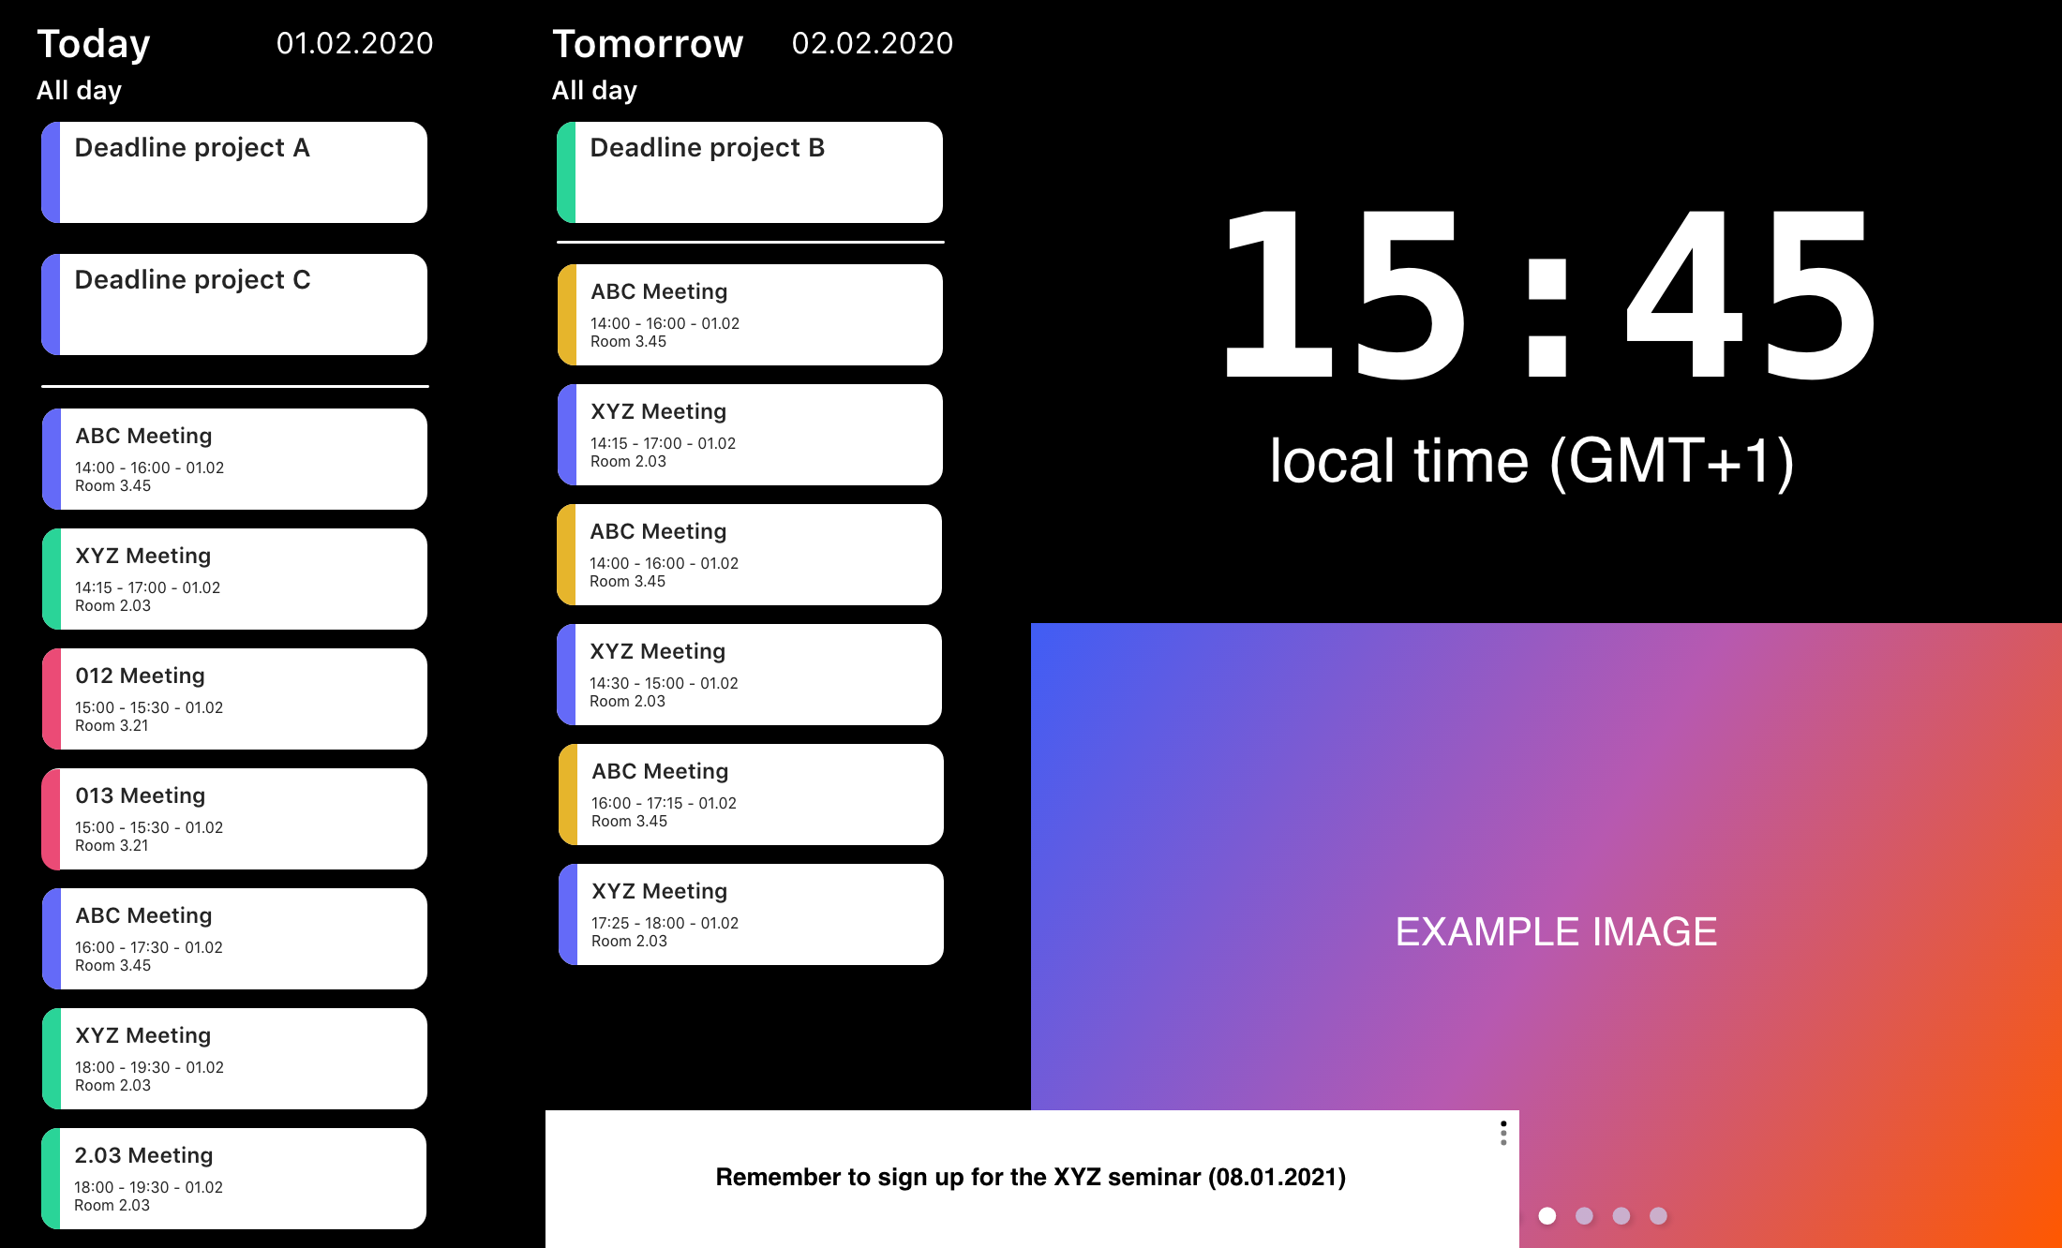
Layout System

Slide 6
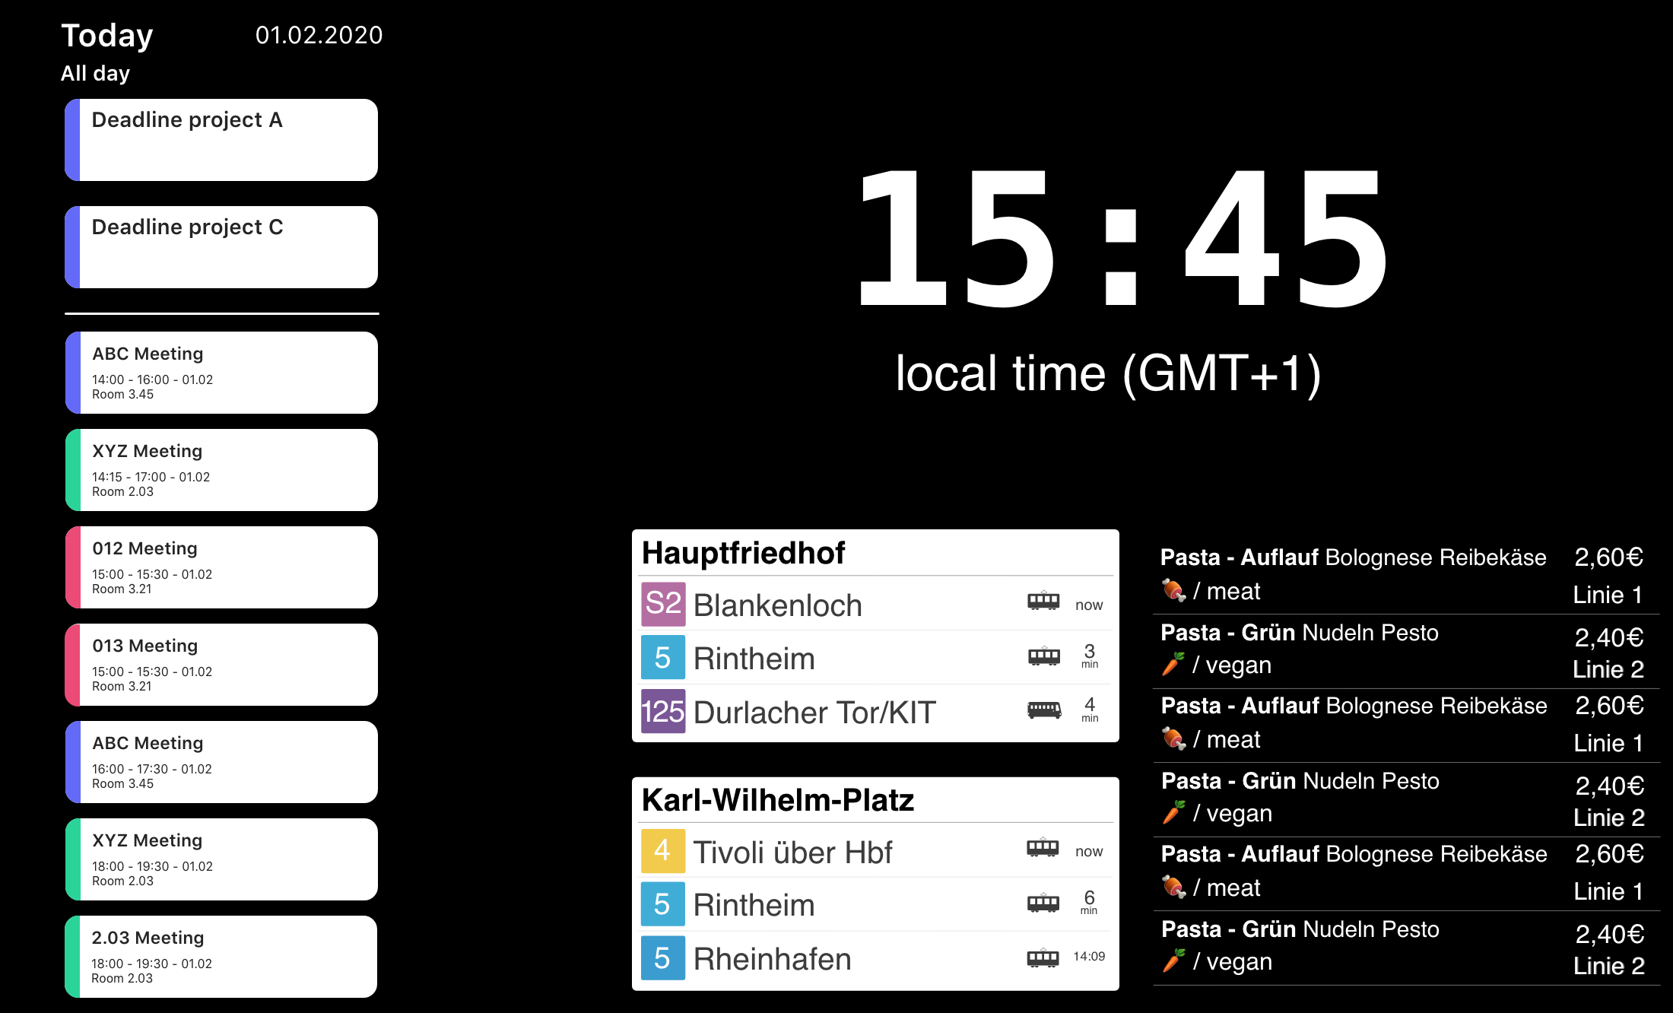
Layout System

Slide 7
Plugin system
Internationalization system
Time-configurable widget display
Permission System

Slide 8
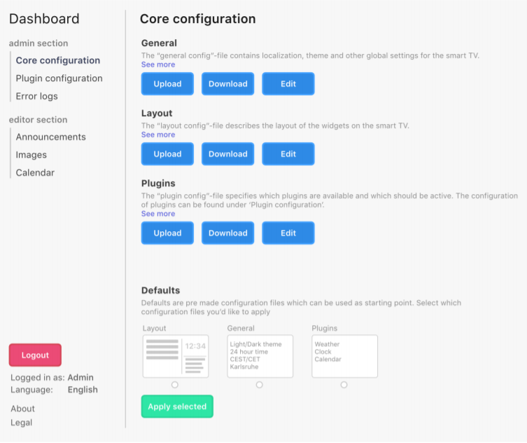
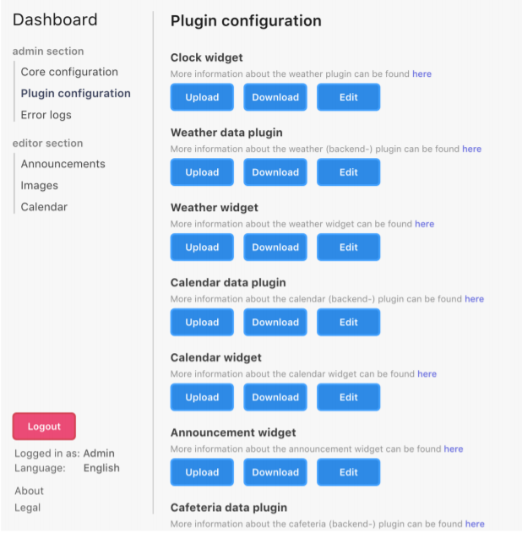
Dashboard for configuration and data entry

Slide 9
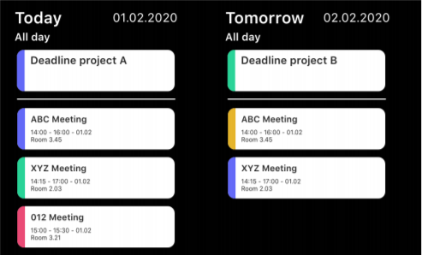
Calendar widget

Slide 10
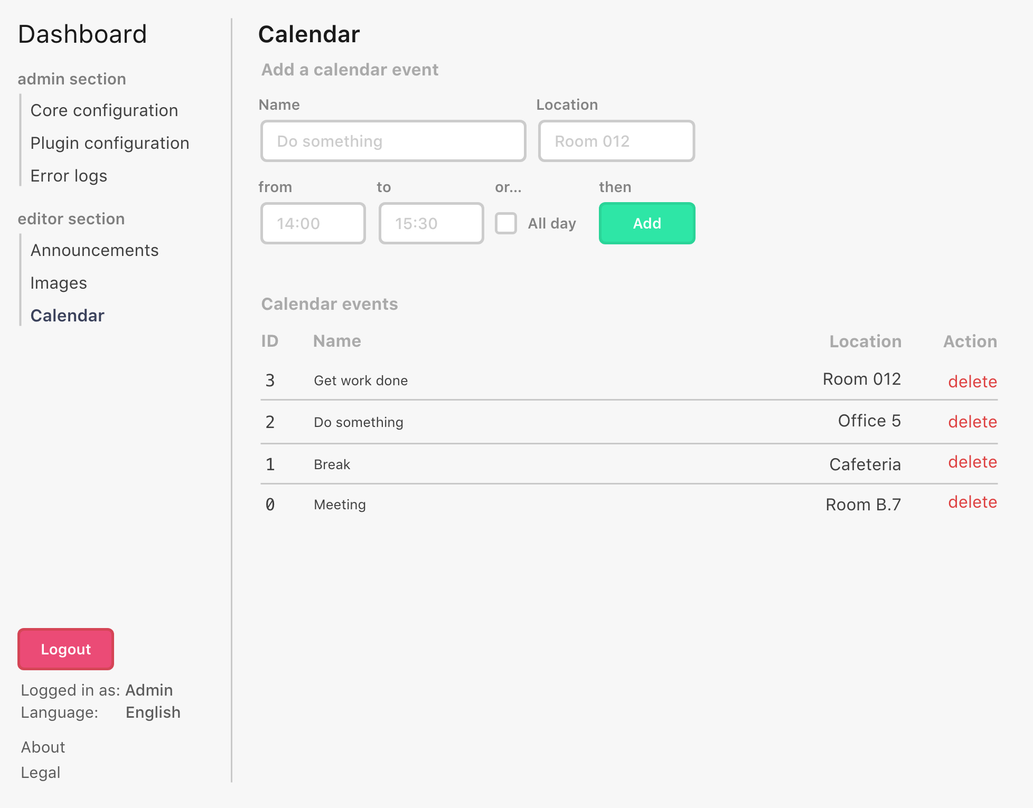
Calendar widget

Slide 11

Publication

Slide 12
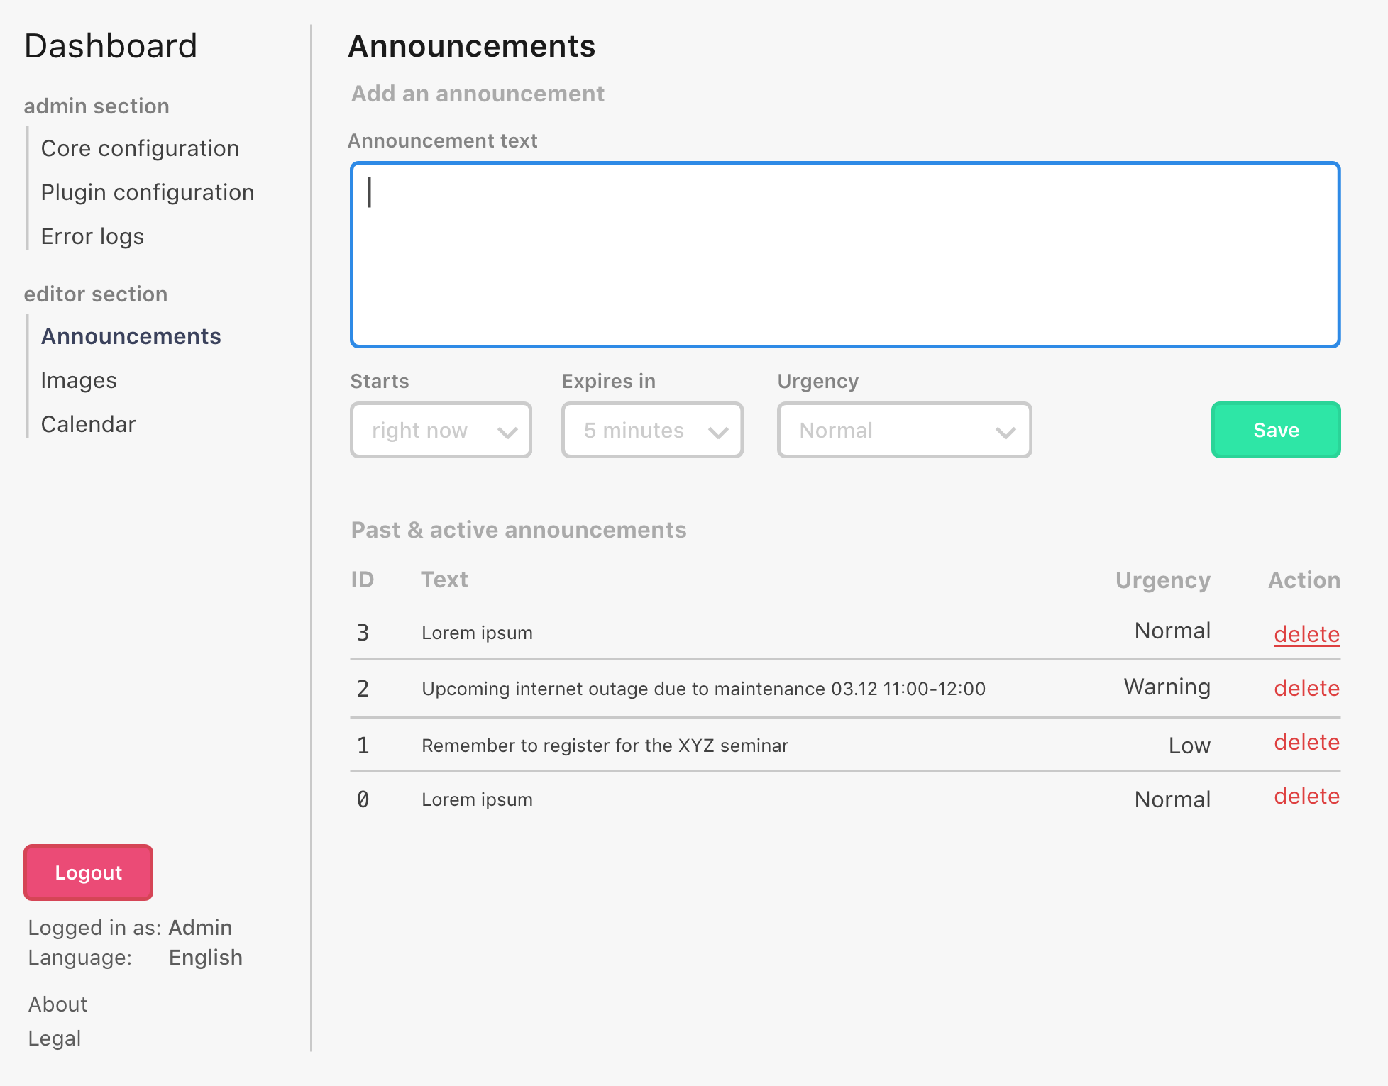
Announcements

Slide 13
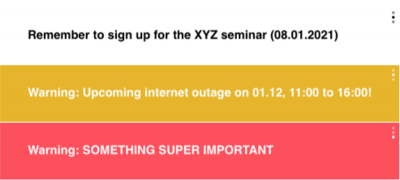
Announcements

Slide 14
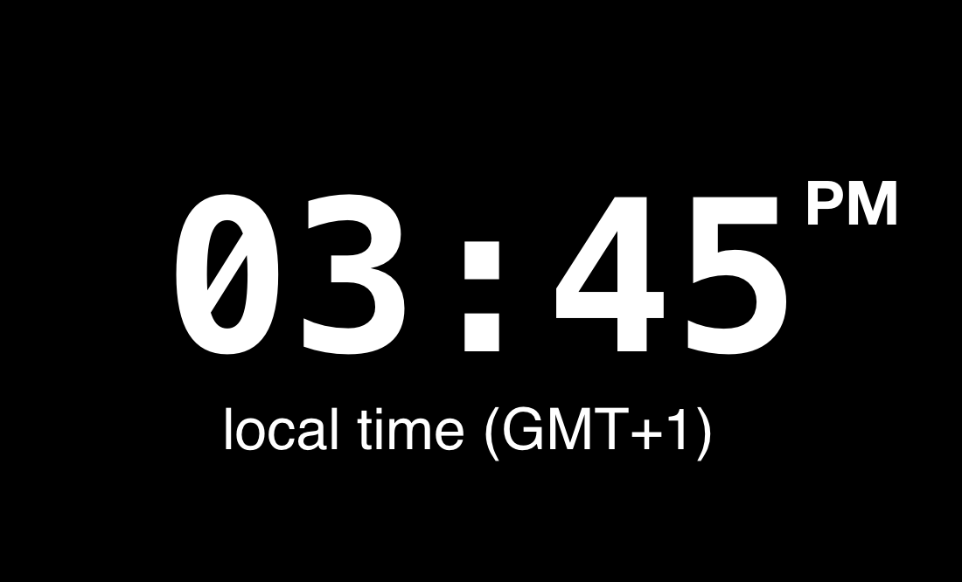
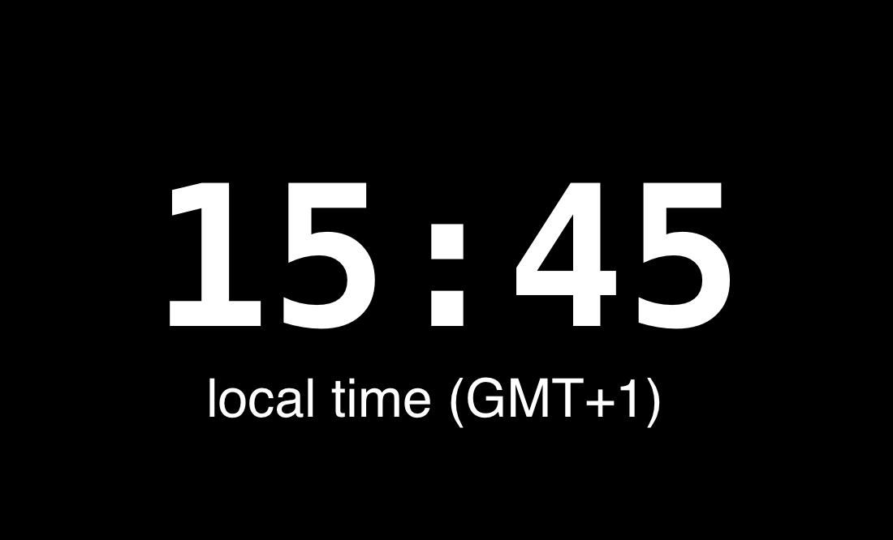
Clock widget

Slide 15
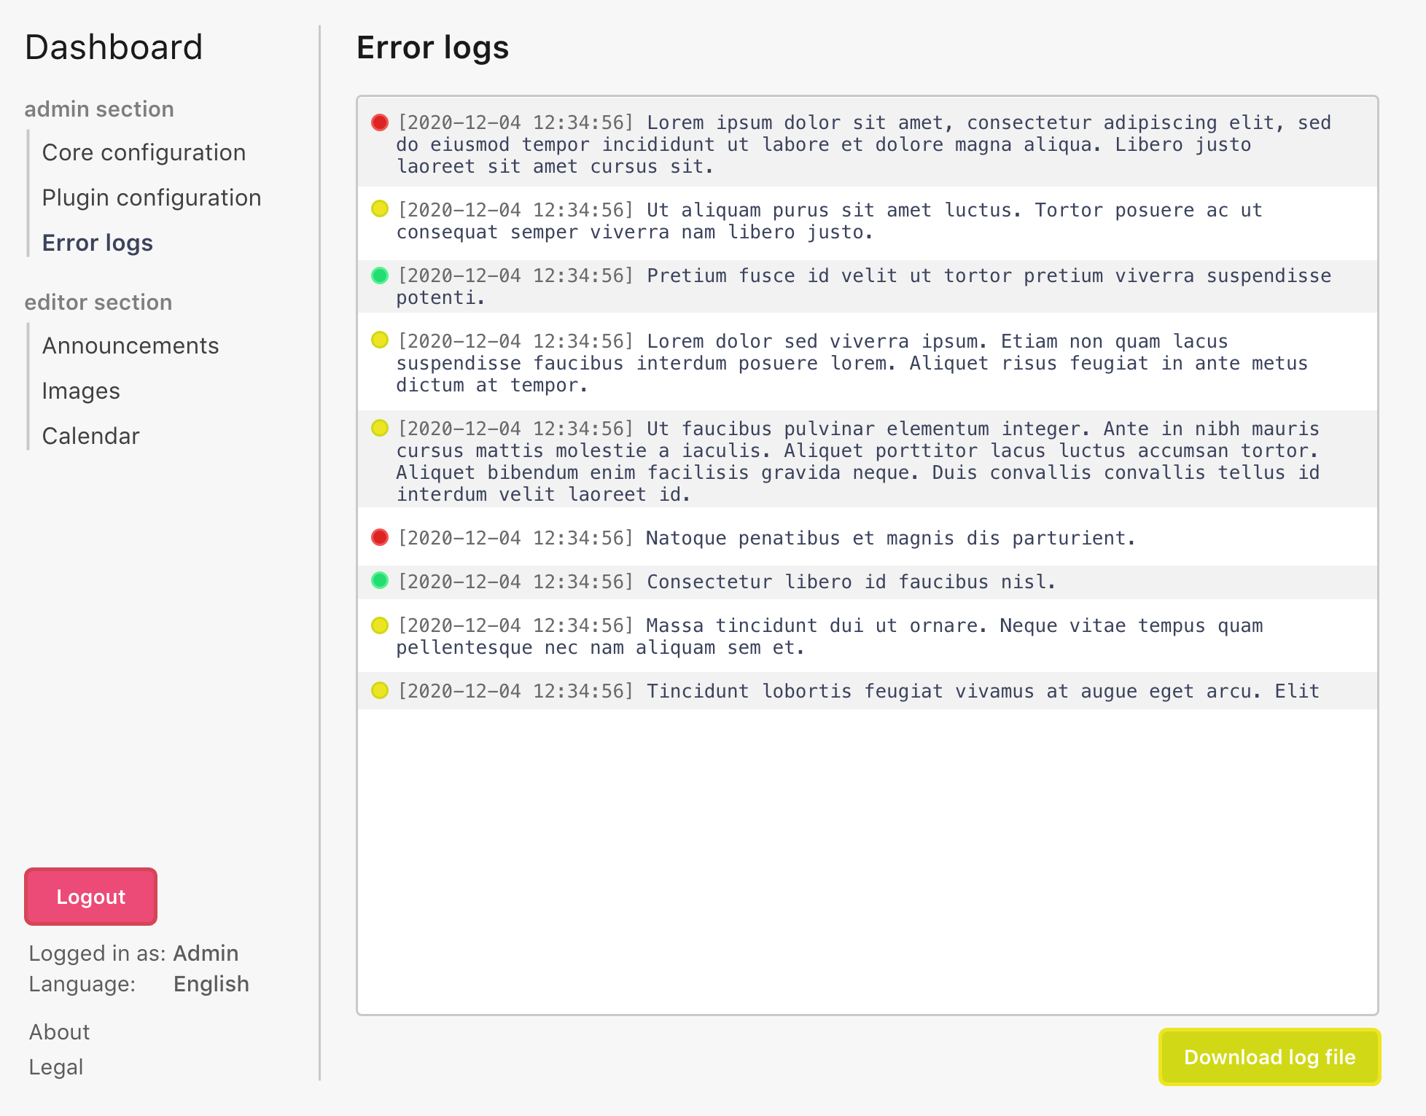
Error logging

Slide 16
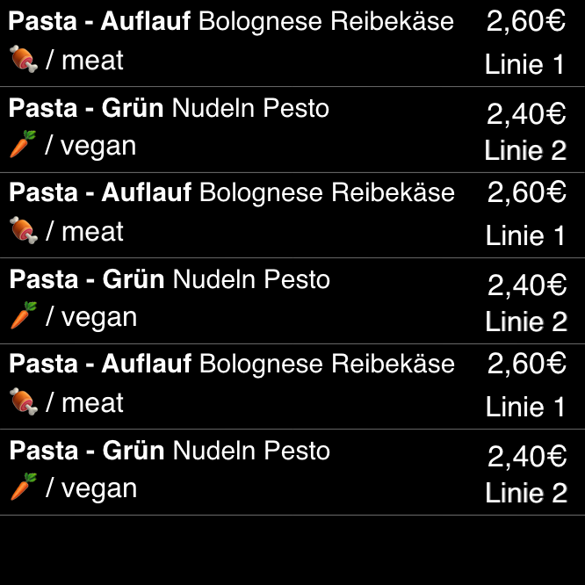
Cafeteria widget

Slide 17
Optional Requirement
Weather widget
Room usage widget
Tram / bus schedule widget
Printer queue widget
Display time of last update
Themeability
RSS feed widget
Image display widget
Server usage widget
Editing config files in the dashboard

Slide 18
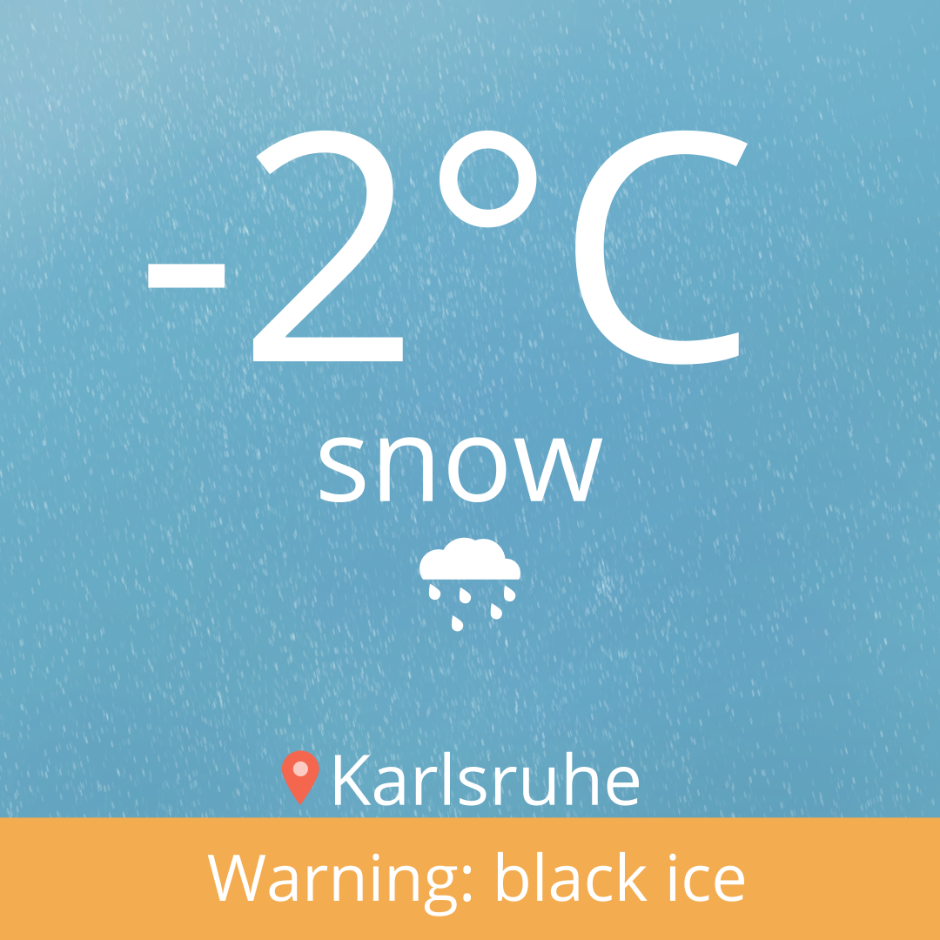
Weather widget

Slide 19
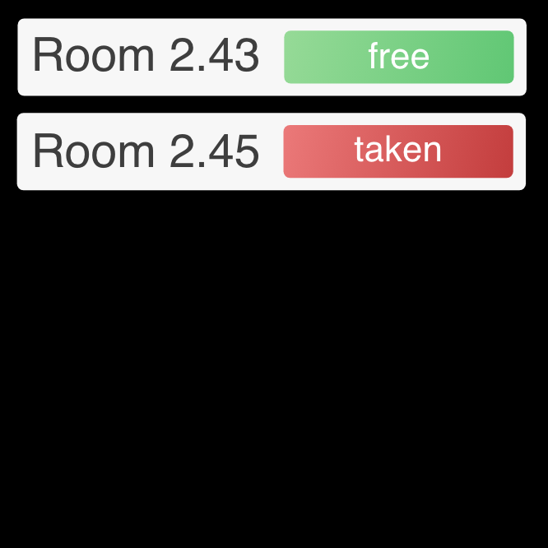
Room usage widget

Slide 20
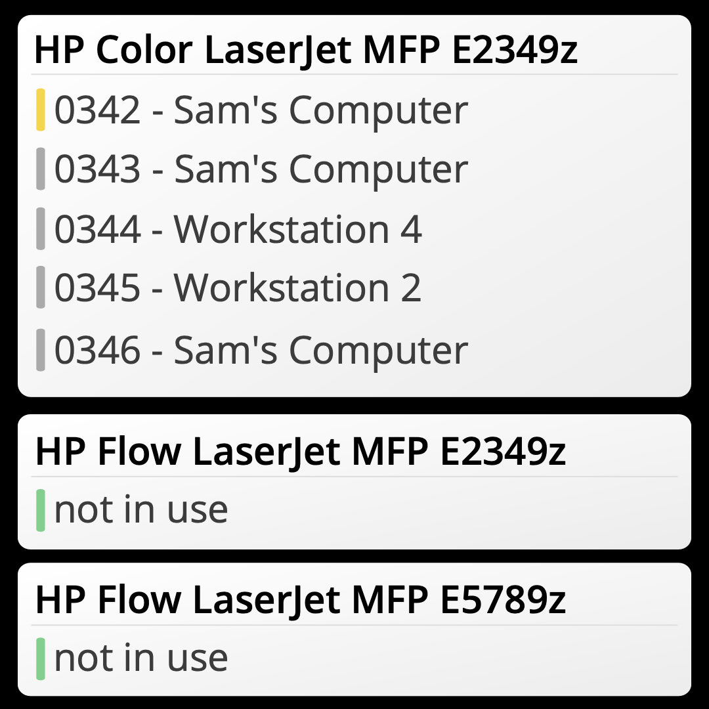
Printer queue widget

Slide 21
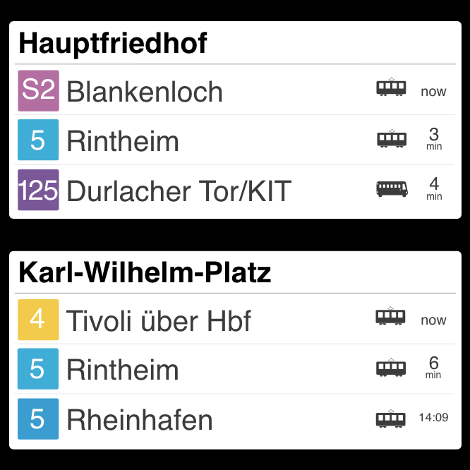
Tram / bus schedule widget

Slide 22
Display time of last update
Themeability

Slide 23
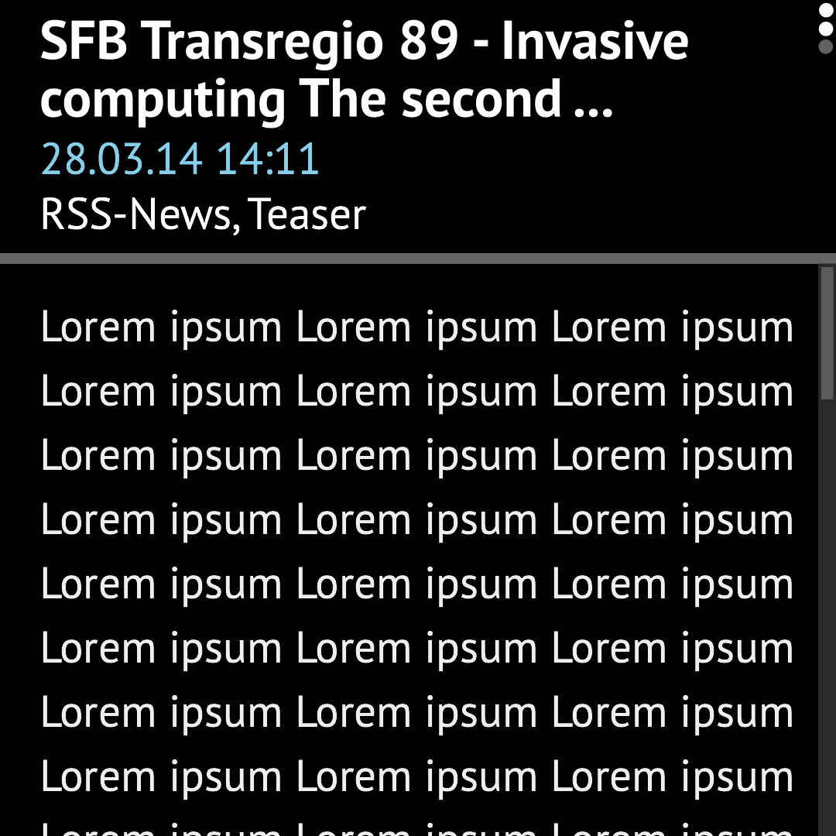
RSS feed

Slide 24

Image display widget

Slide 25
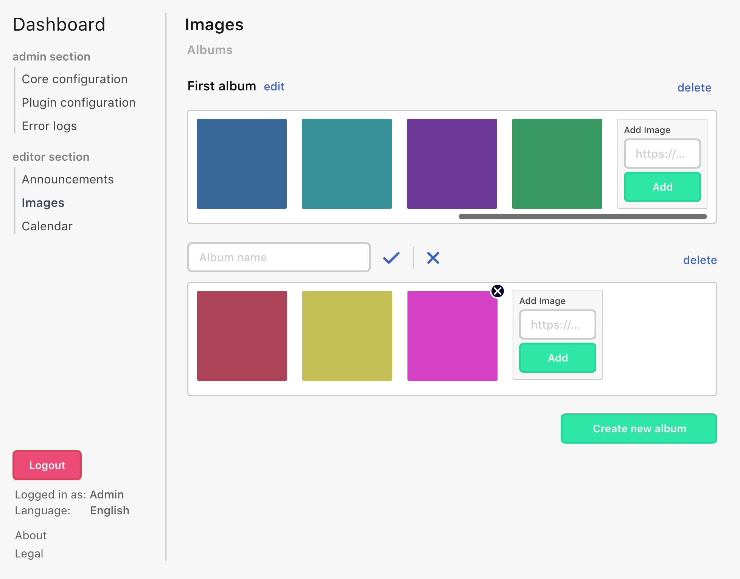
Image display widget

Slide 26
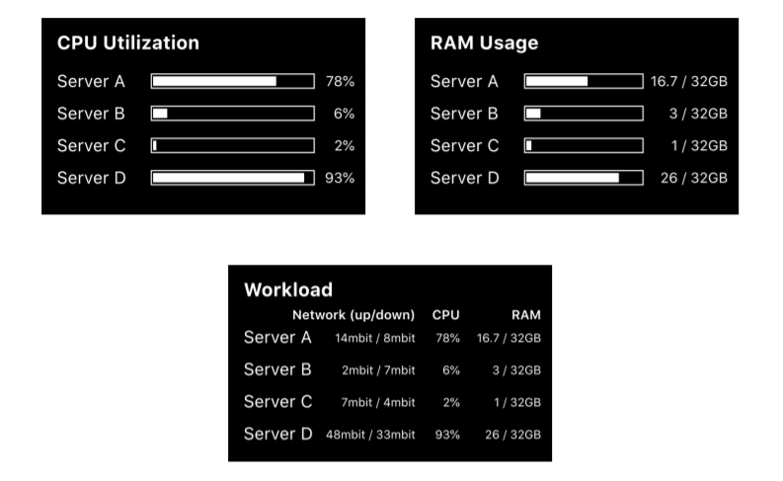
Server usage widget

Slide 27
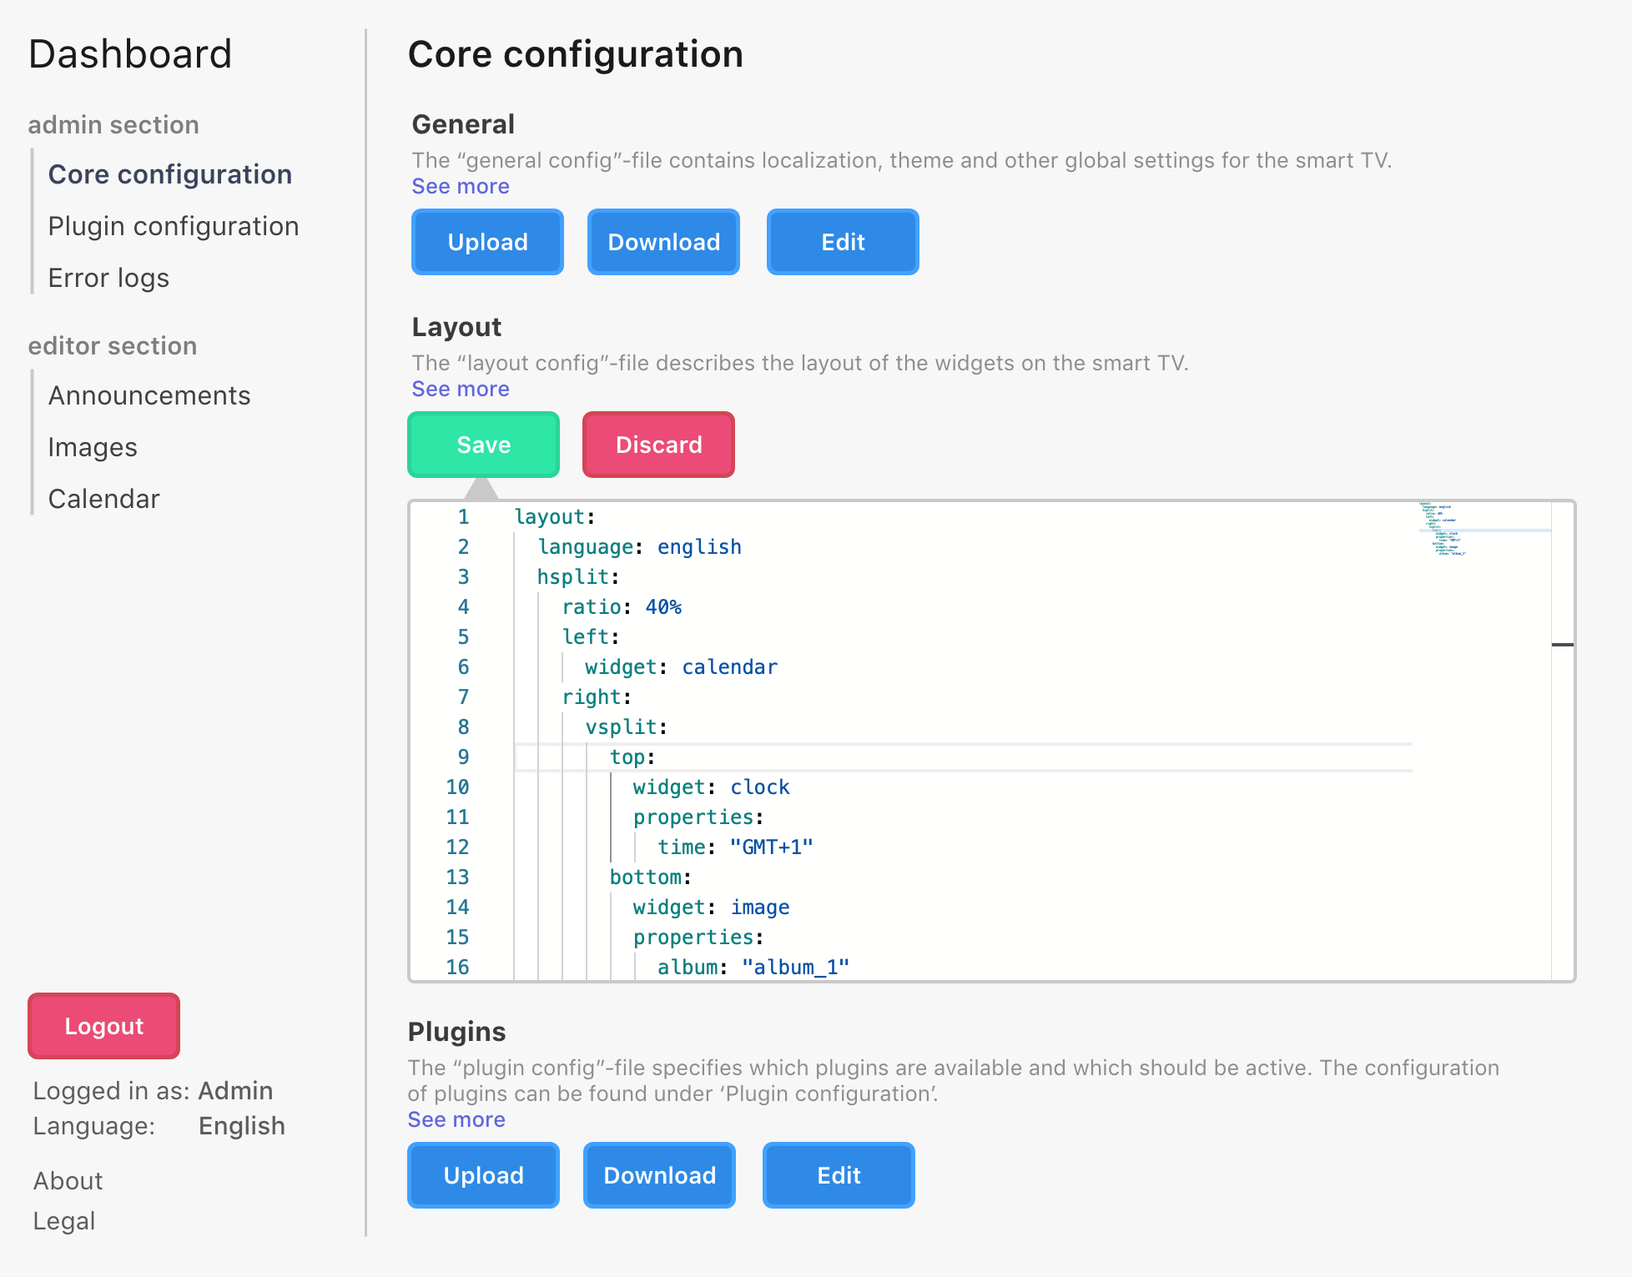
Editing config files

Slide 28
Non-Functional Requirements
Extensibility
Reliability
Security Requirements
Easy to set up and use
Privacy Requirements

Slide 29
Thank you for your attention
Any questions left?

